Slide 1
[Crunch Honey]
Gerard Ferrante

Slide 2
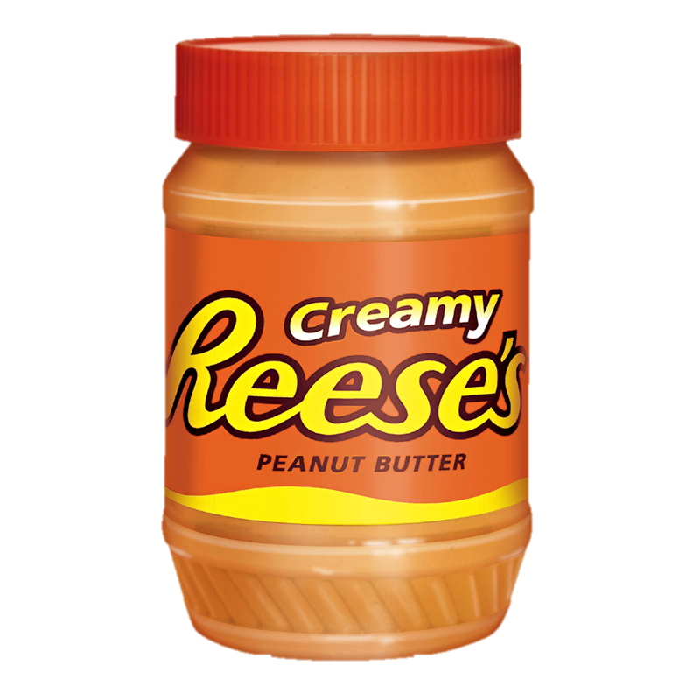
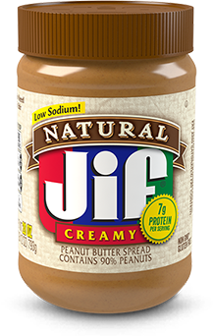

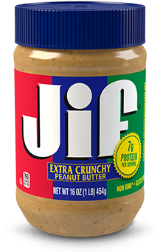
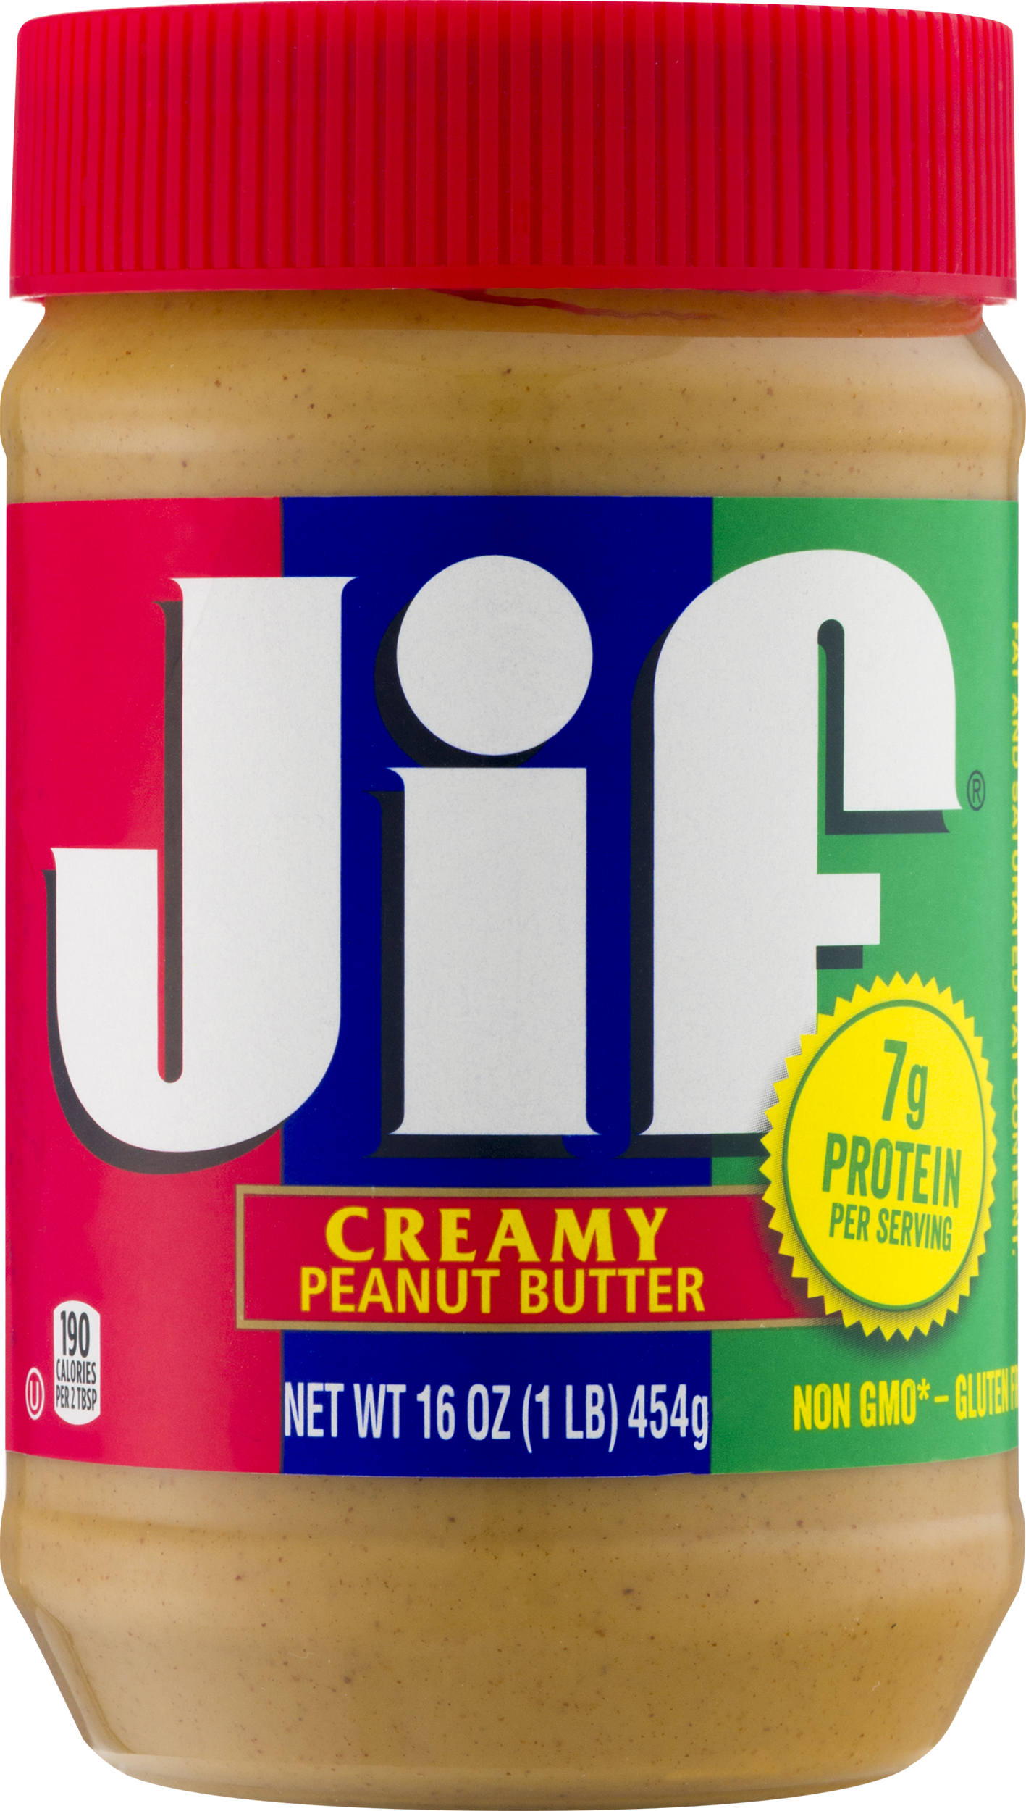
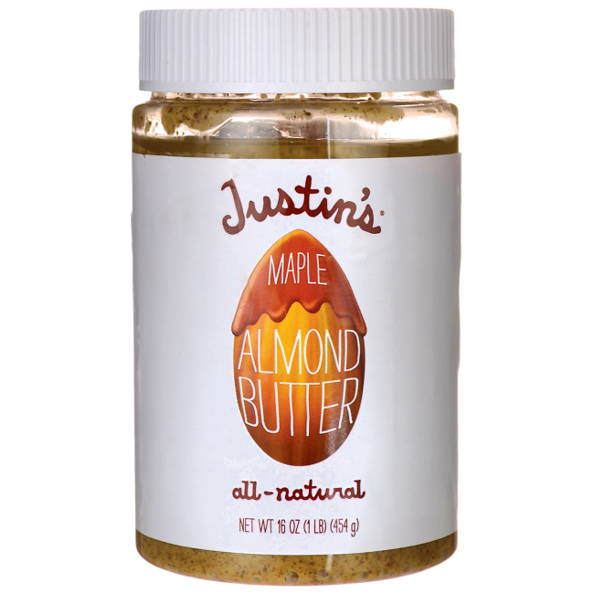
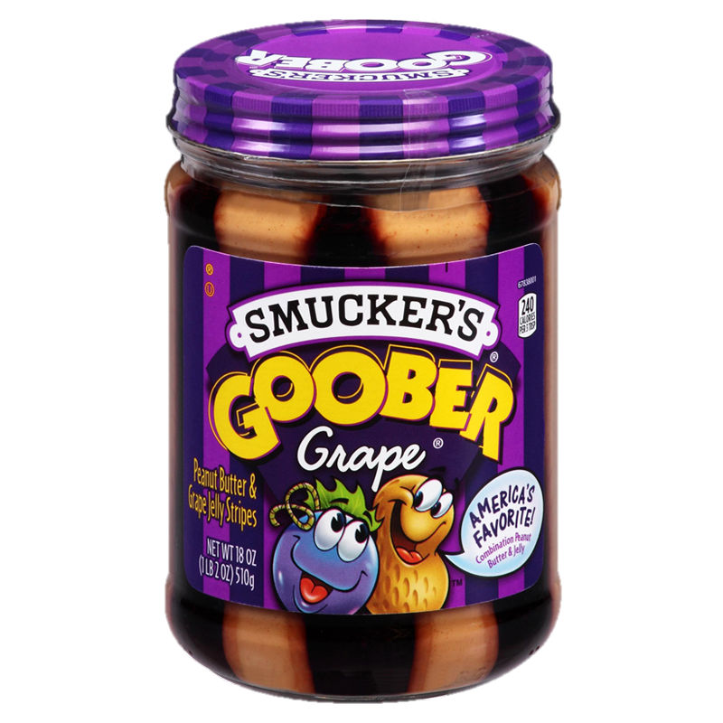
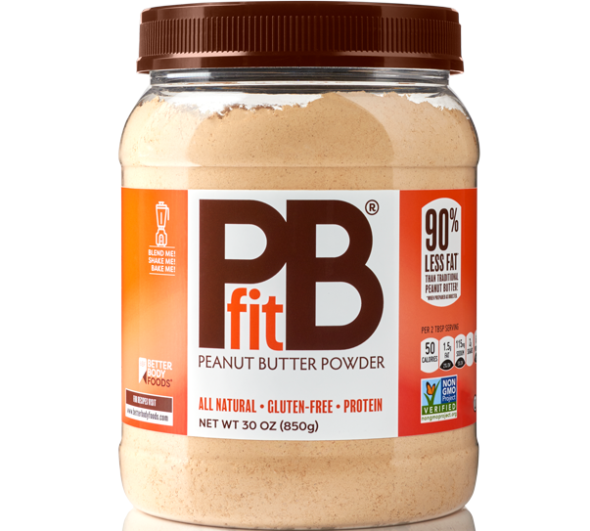
[who are we?]
[?]
Notes:
-first ‘smooth’ peanut butter created in 1922
-fifteen years later we had chunky peanut butter

Slide 3
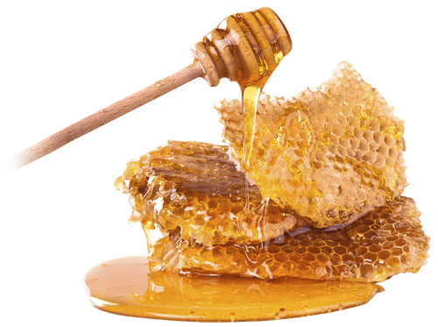
[Crunchy Honey]

Slide 4
[our plan]
-advertisement
-philanthropy

Slide 5
[advertisement]
-penetrate existing market
-eliminate imports
*facts via Alberta department of agriculture
Notes:
574.1 million pounds of honey consumed in the US/year,
~3% increase/yr
***
~65% of honey is imported to meet American demand
~brand ourselves as a US company, create jobs

Slide 6

[philanthropy]
-emotional appeal
-active change
Notes:
People like to attach themselves to companies with a cause

Slide 7


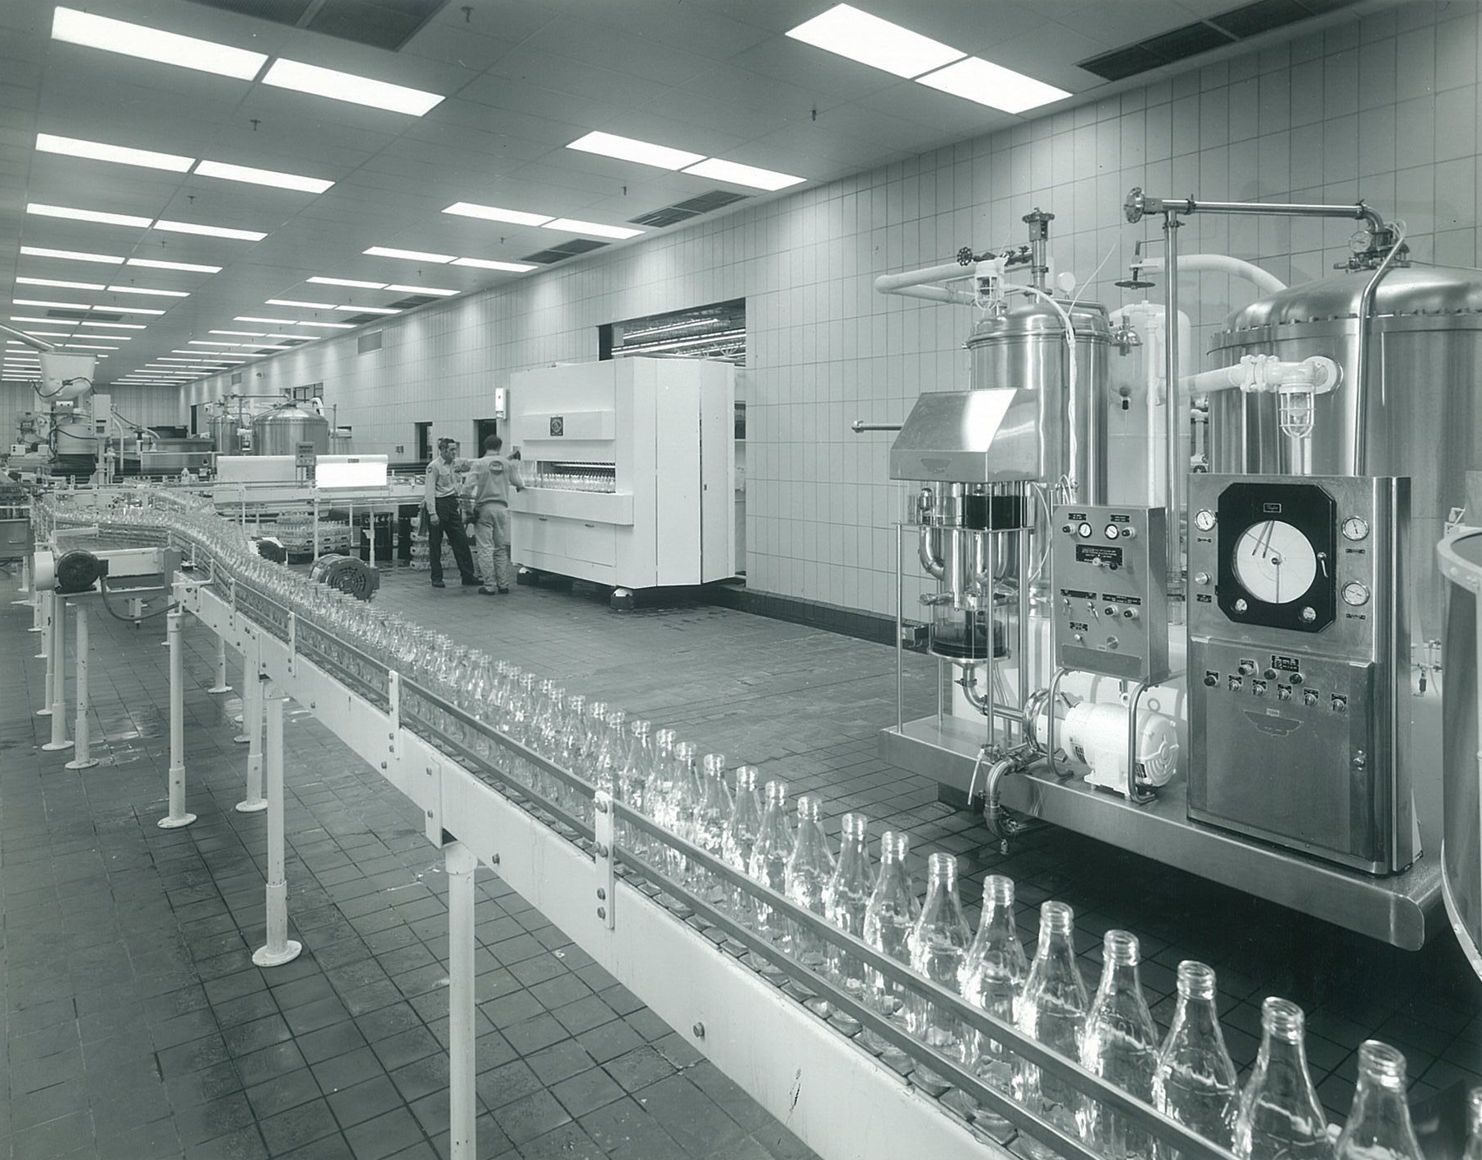
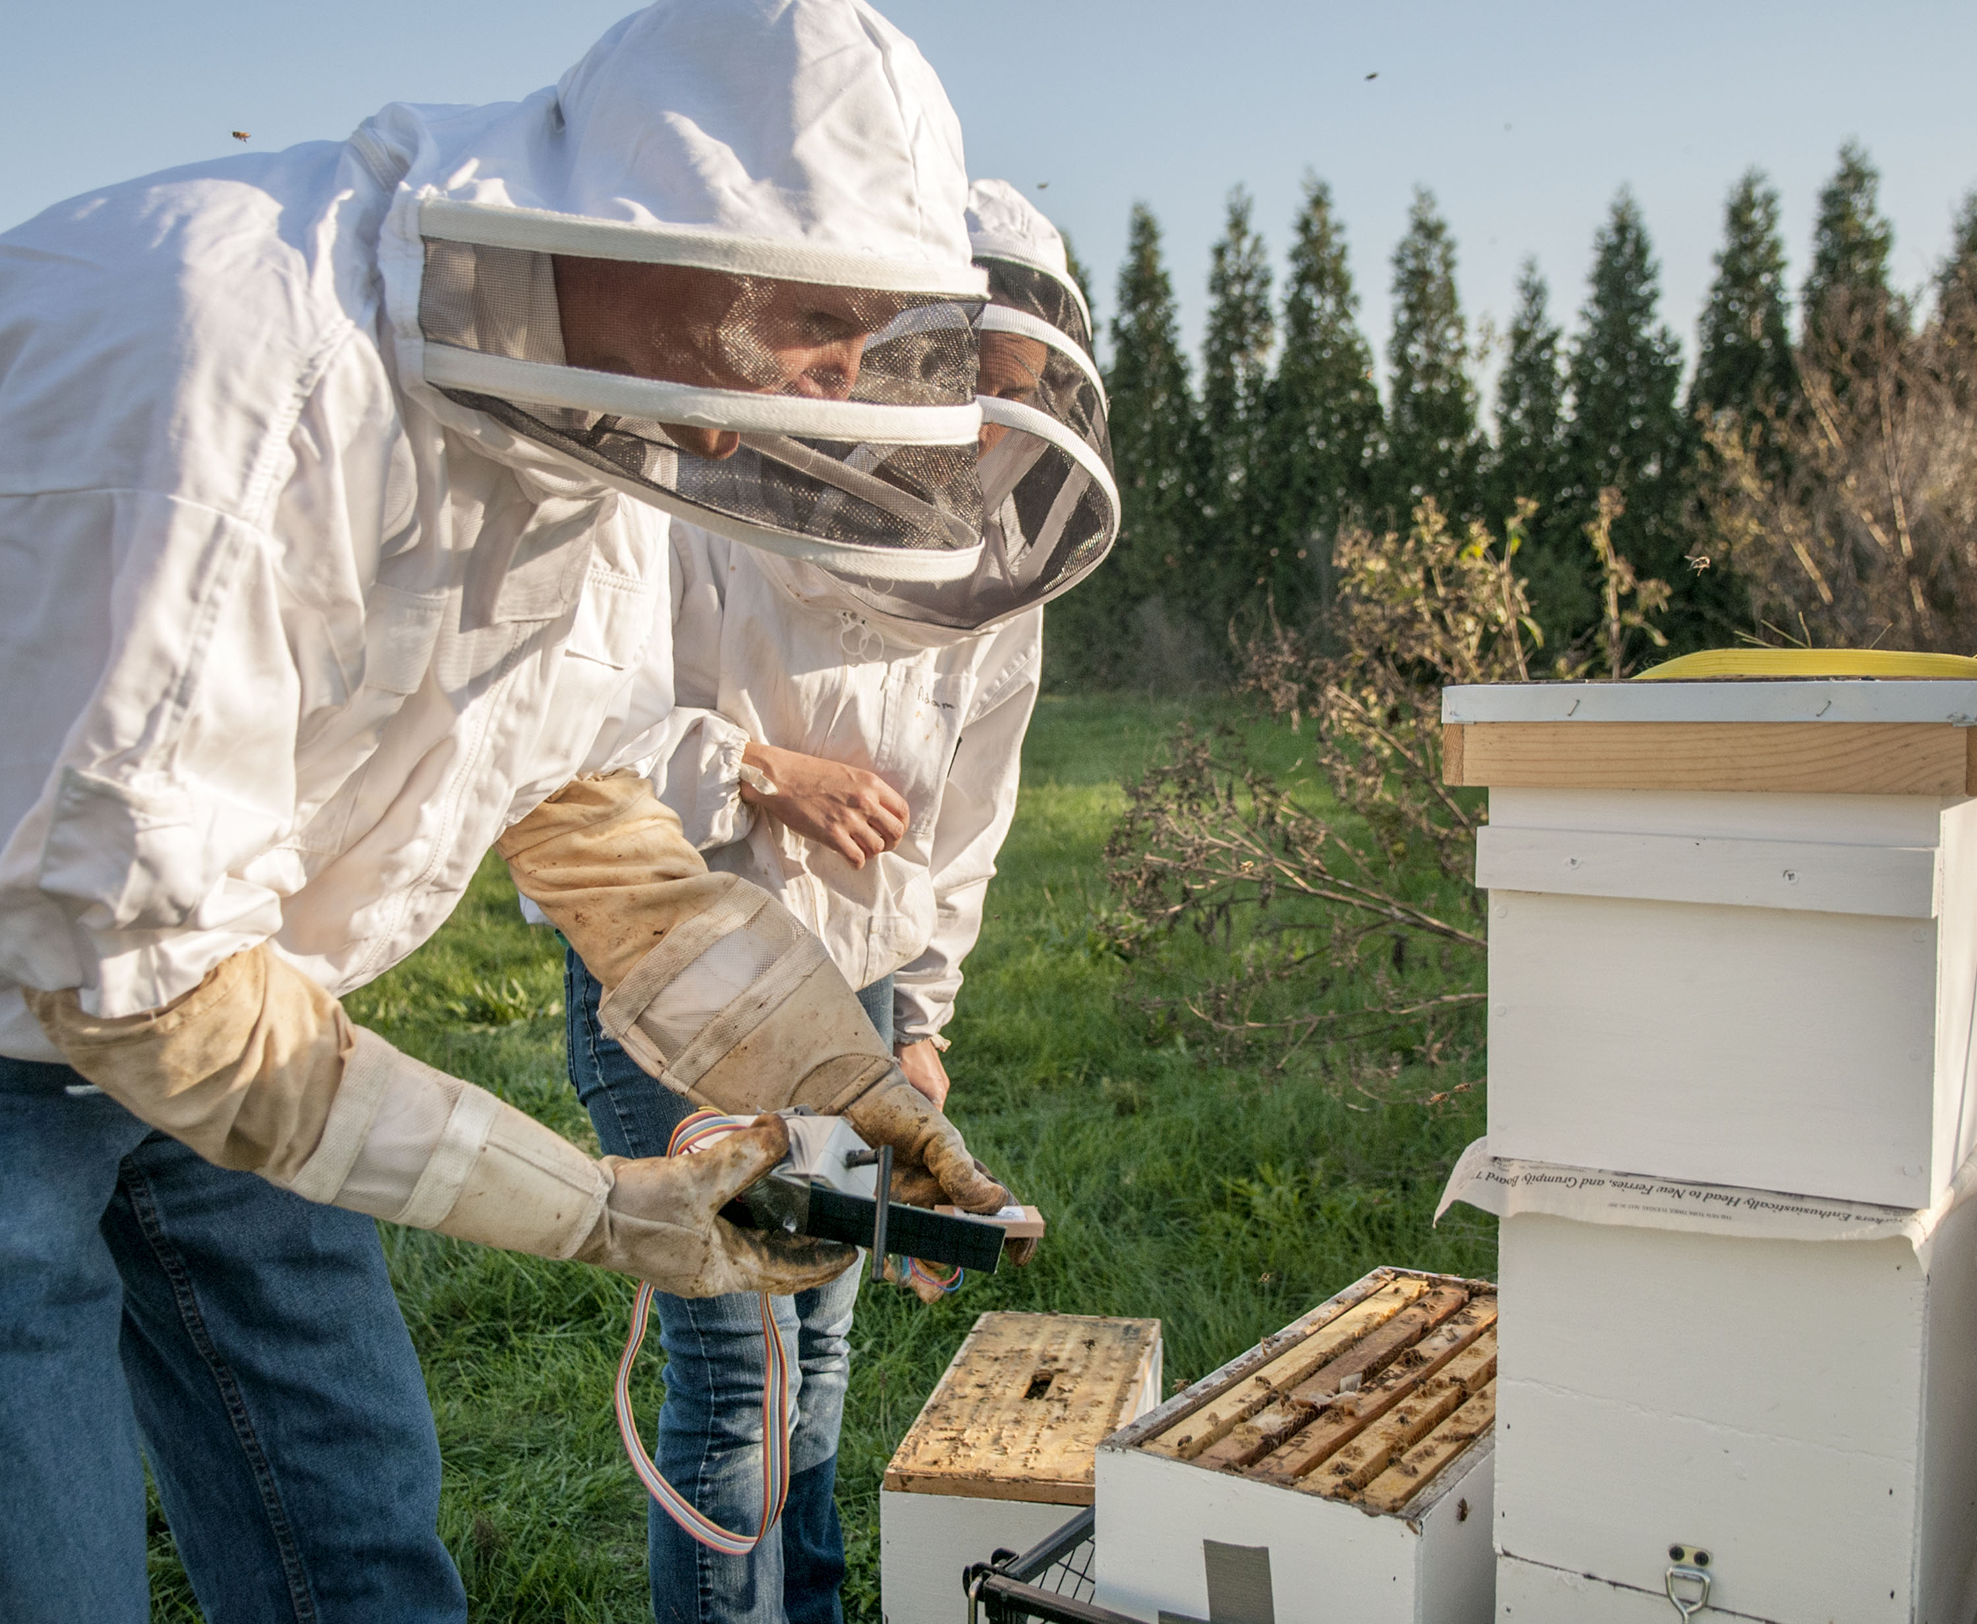

[your investment]
-$250k investment --> 2%
Notes:
1 million dollars will get us:

Slide 8
[?]

